Slide 1
生物資訊學導論-期末報告
Final Presentation
H₂O₂ 與植物荷爾蒙之差異性表現基因關聯性探討
吳晉宇 (d01623001)
謝誌紘 (r06b42001)
曾柏舜 (r07b42006)
劉宗晏 (r07b42009)
組別：第九組
報告日期：2019/01/04

Slide 2
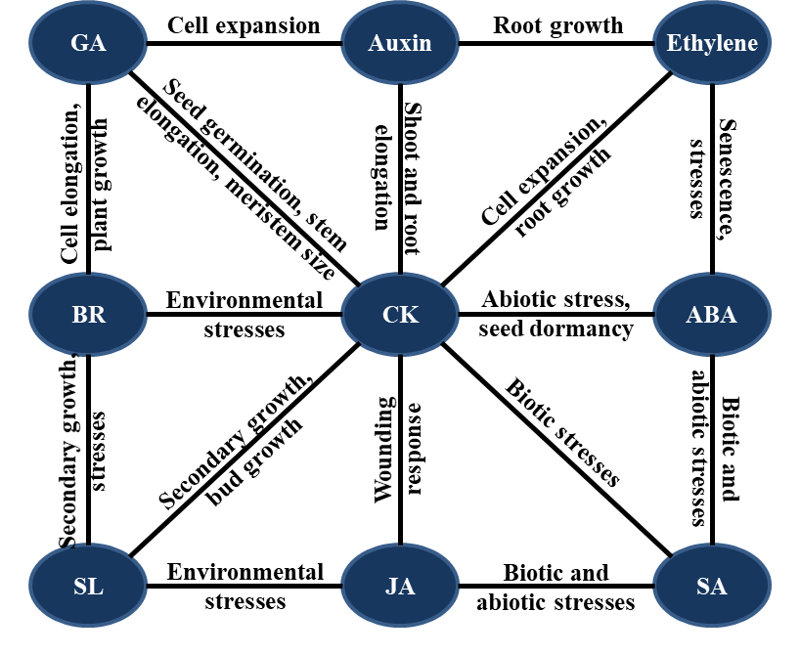
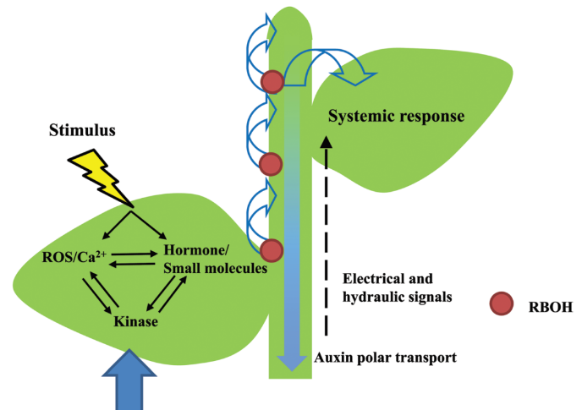
Introduction
H₂O₂
?
Which hormone ?

Slide 3


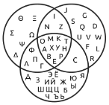


Workflow
Analysis pipeline
Data resource (Rice 44K MicroArray)
01
H₂O₂ (10mM, 1hr) V.S. RiceXpro Hormone (1hr)
Differential express gene analysis
02
R package limma (Linear Models for Microarray Data)
Venn diagram
03
R package Venn (Version 1.7 Update Date: 2018-07-31)
Gene ontology analysis
04
AgriGO v2 web analysis tool, PANTHER

Slide 4
Volcano Plot
Log Fold change > 1 or < -1
Adj. p-value < 0.05
4

Slide 5
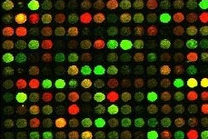
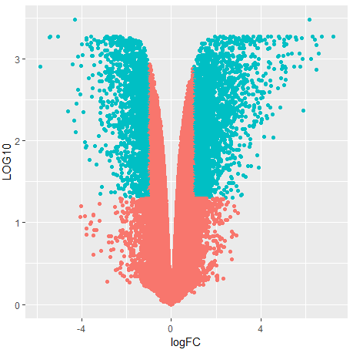
Differential express gene analysis
LogFC < -1
LogFC > 1
P-value < 0.05
P-value > 0.05
Control (WT)
V.S
10mM H2O2 treatment 1 hr

Slide 6
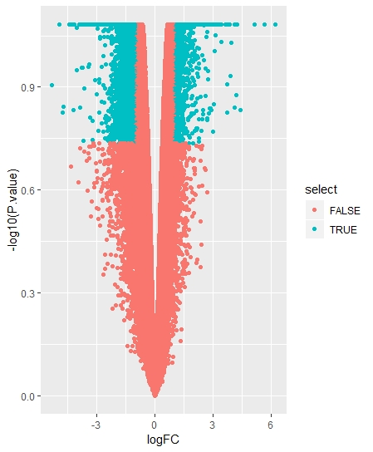
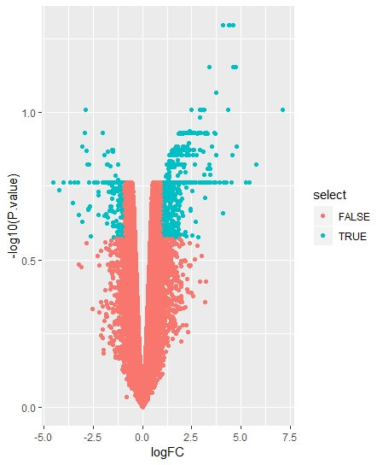
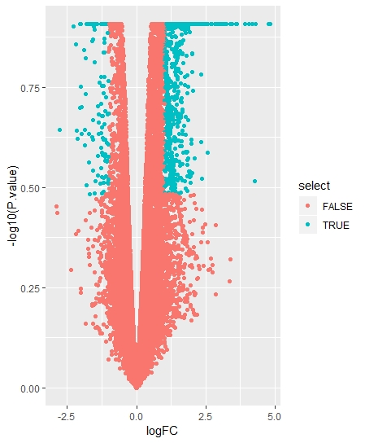
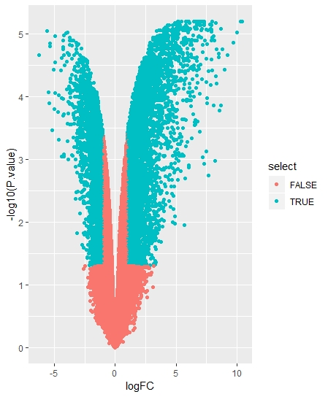
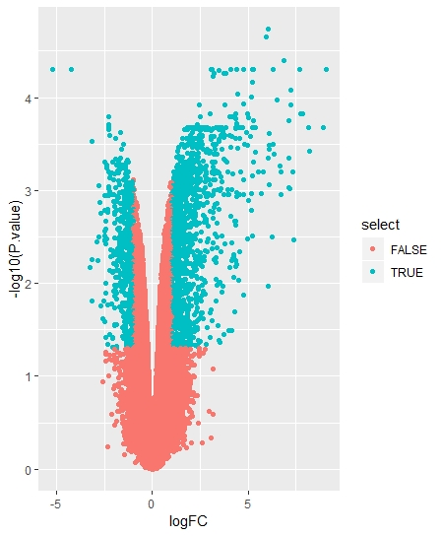
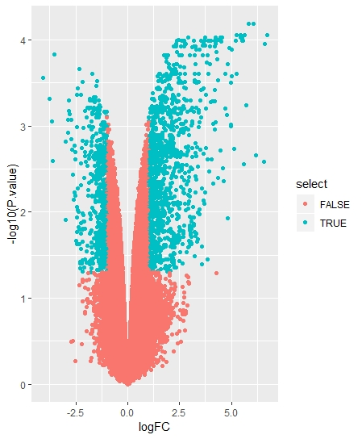
Shoot
Root
JA
ABA
Auxin

Slide 7
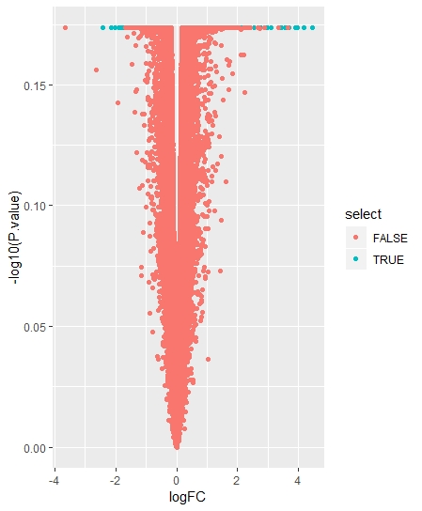
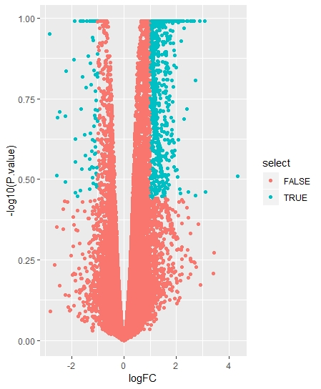
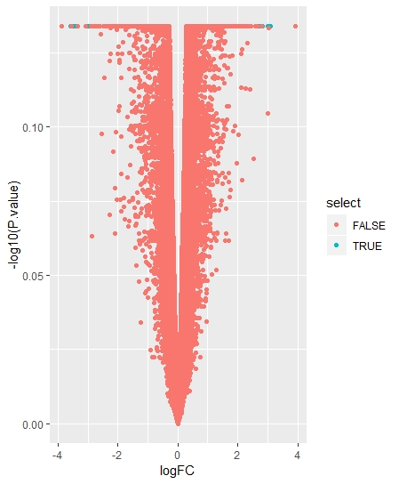
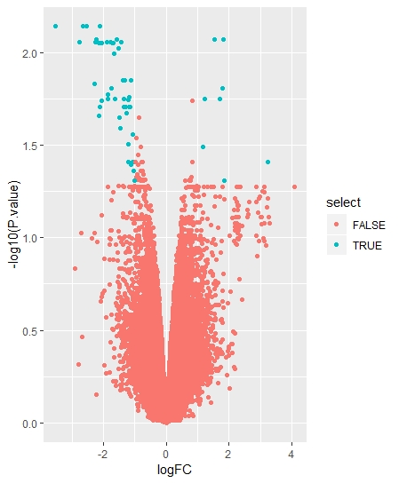
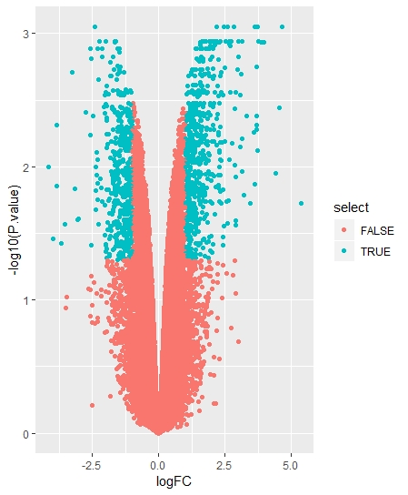
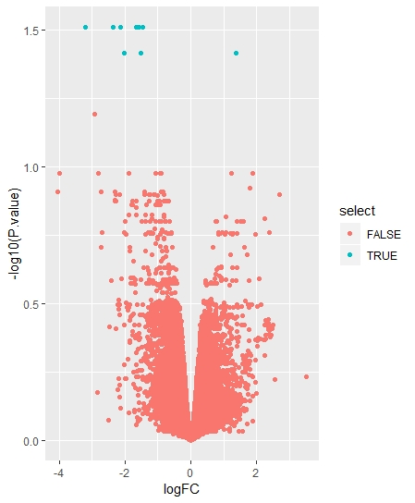
Shoot
Root
BL
CK
GA

Slide 8
ROOT

Slide 9
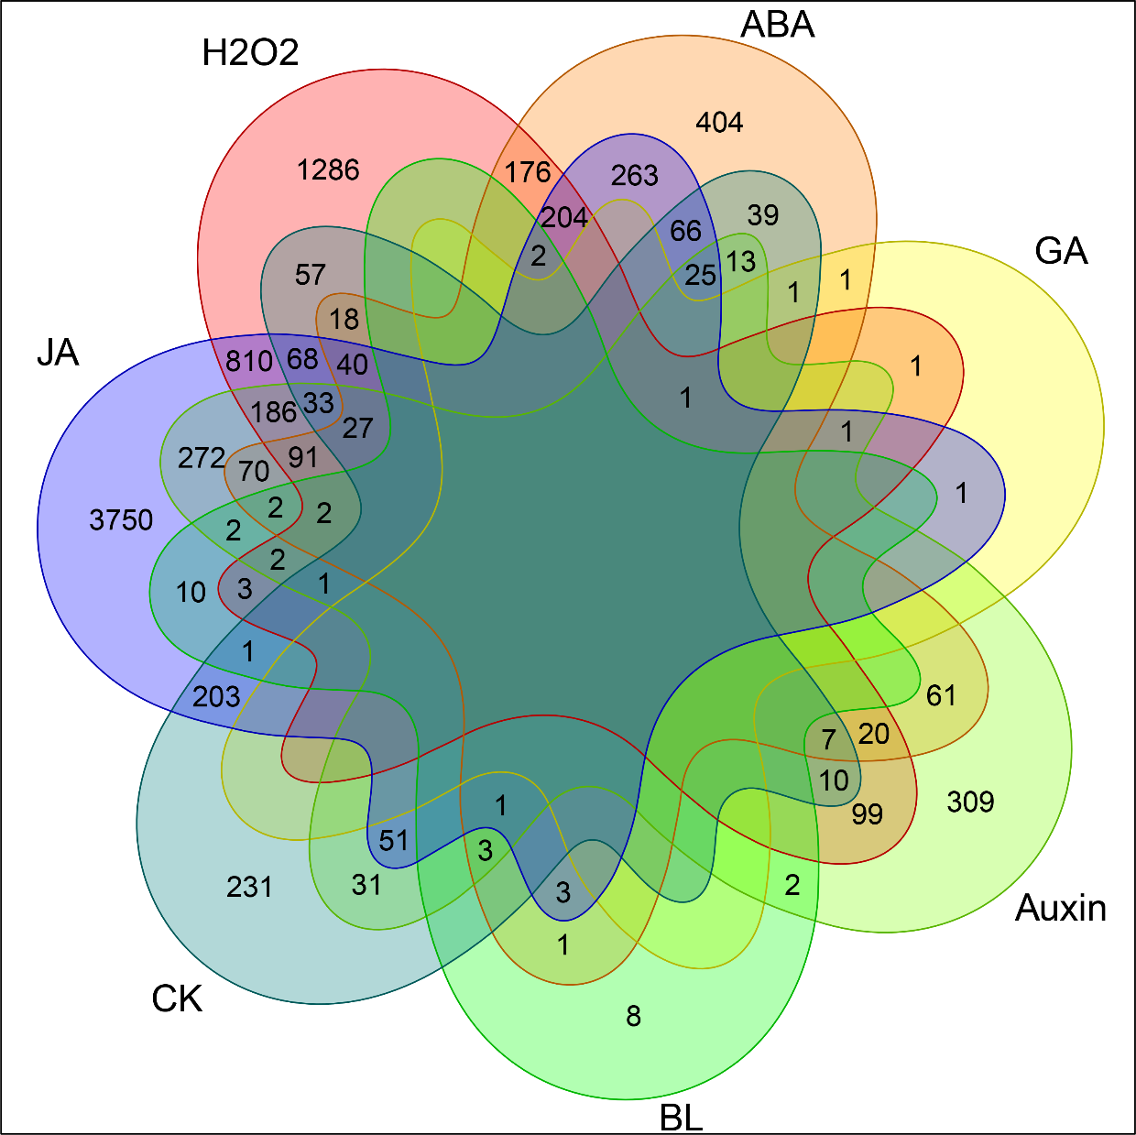
Results
GA與BL所調控之基因在根部較少
9

Slide 10
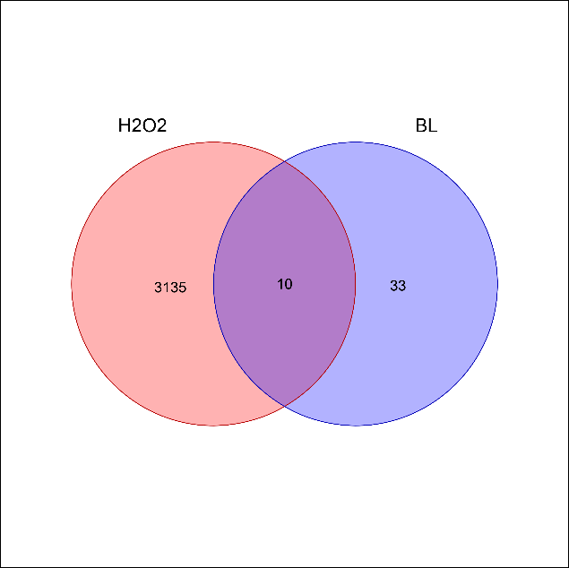
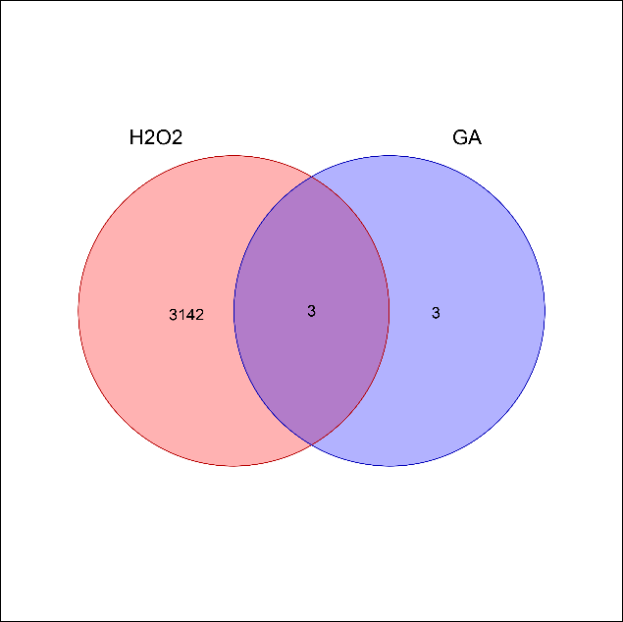
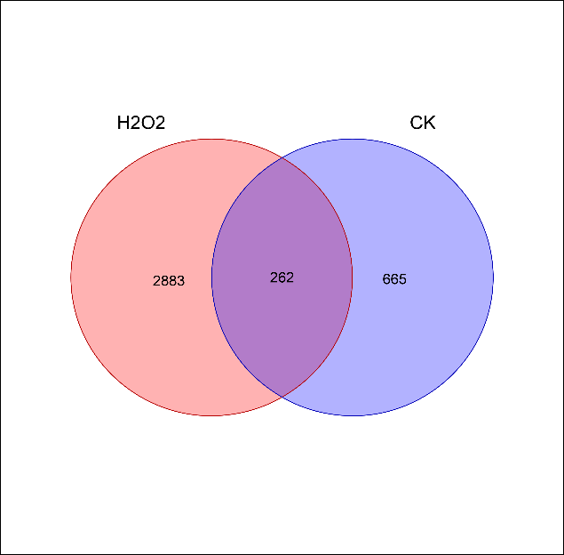
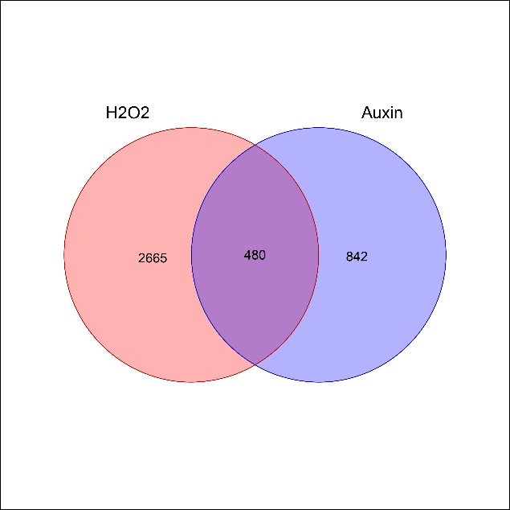
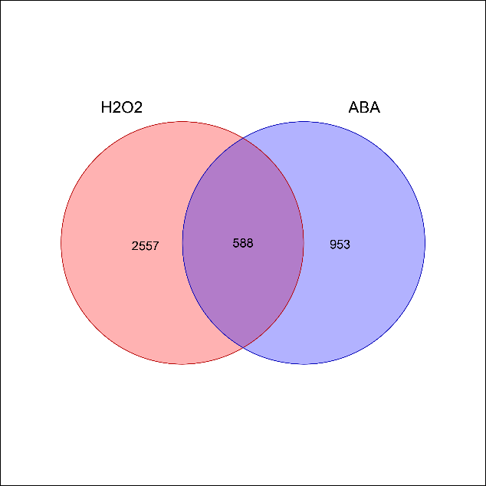
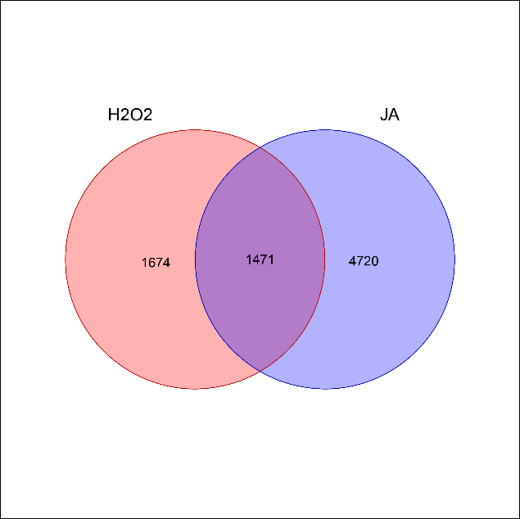
Venn Plots
H₂O₂差異性表現基因數3145個
BL
GA
CK
Auxin
ABA
JA
10

Slide 11
Venn Plots
23.26%
50.00%
28.26%
BL
GA
CK
43
6
927
Auxin
ABA
JA
1322
1541
6191
36.31%
38.15%
23.76%
11

Slide 12
SHOOT

Slide 13
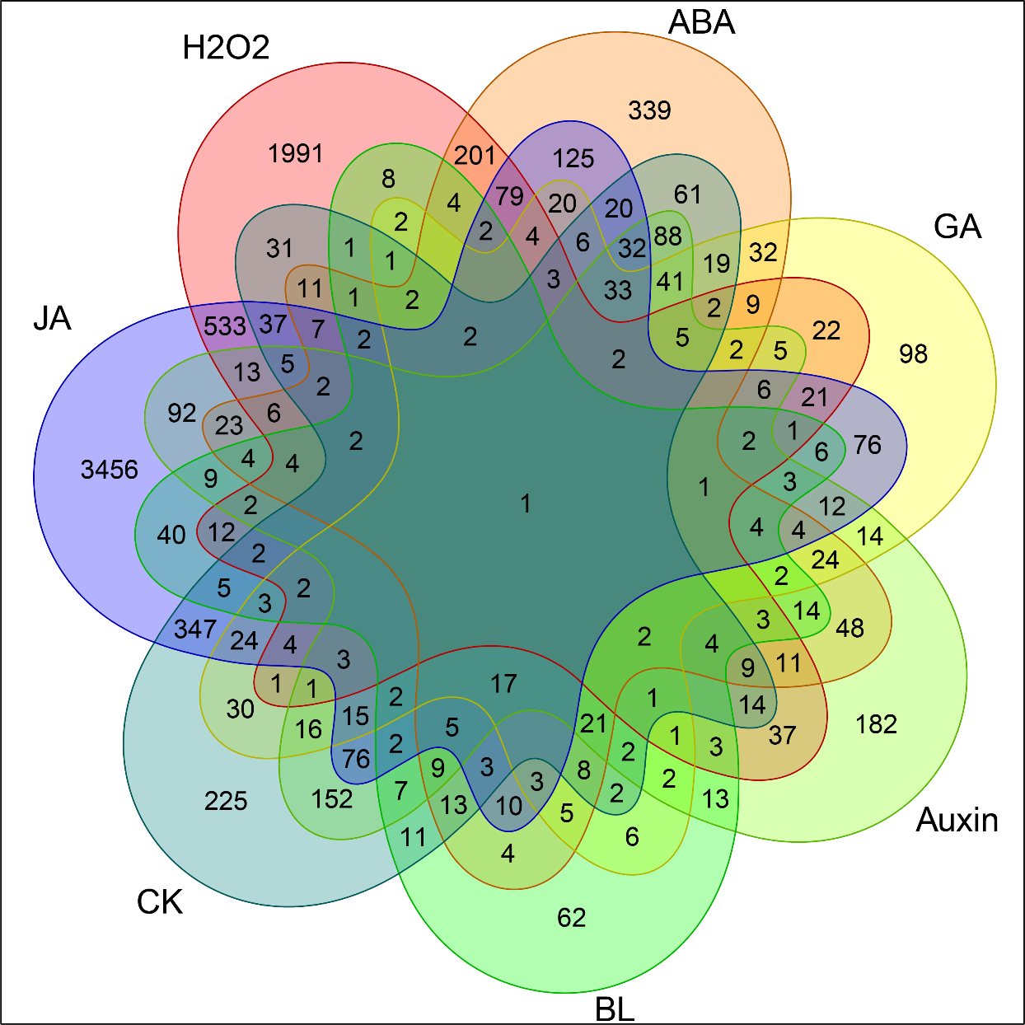
Results
13

Slide 14
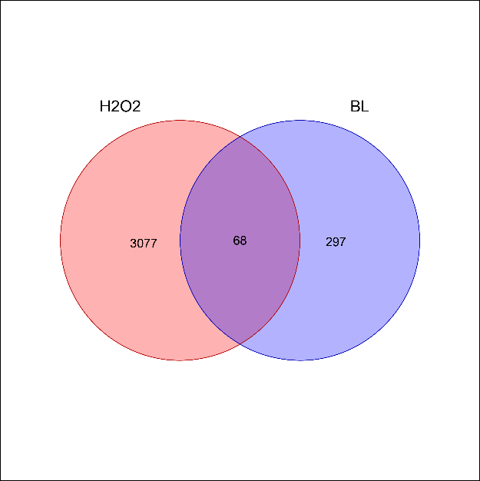
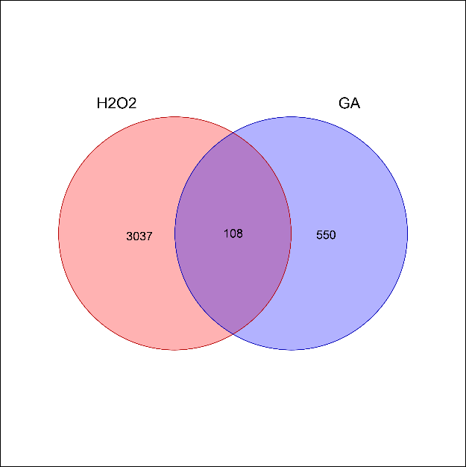

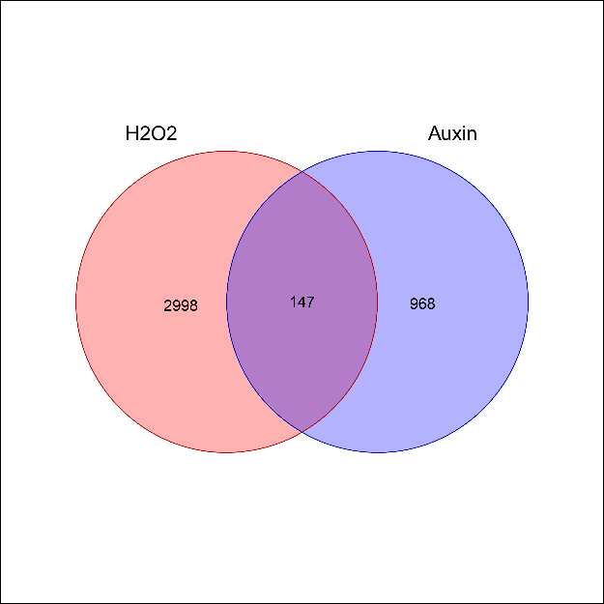
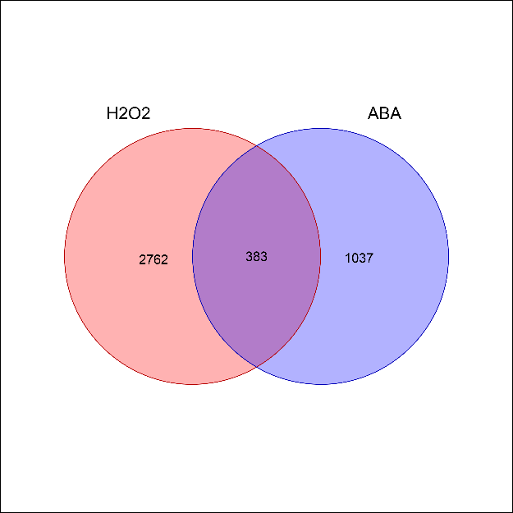
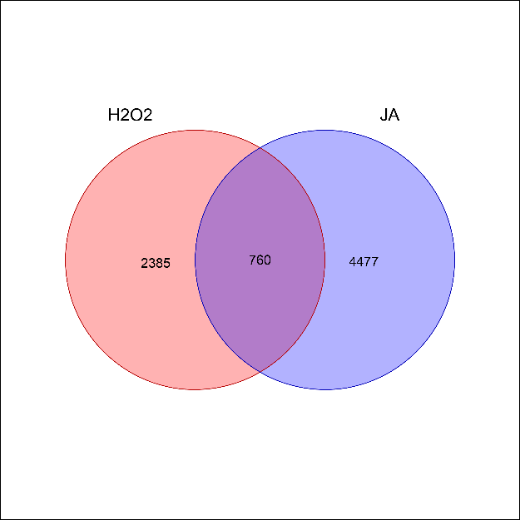
Venn Plots
H₂O₂差異性表現基因數3145個
BL
GA
CK
Auxin
ABA
JA
14

Slide 15
Venn Plots
18.63%
16.41%
11.00%
BL
GA
CK
365
658
1455
Auxin
ABA
JA
1115
1420
5237
13.18%
25.85%
14.51%
15

Slide 16
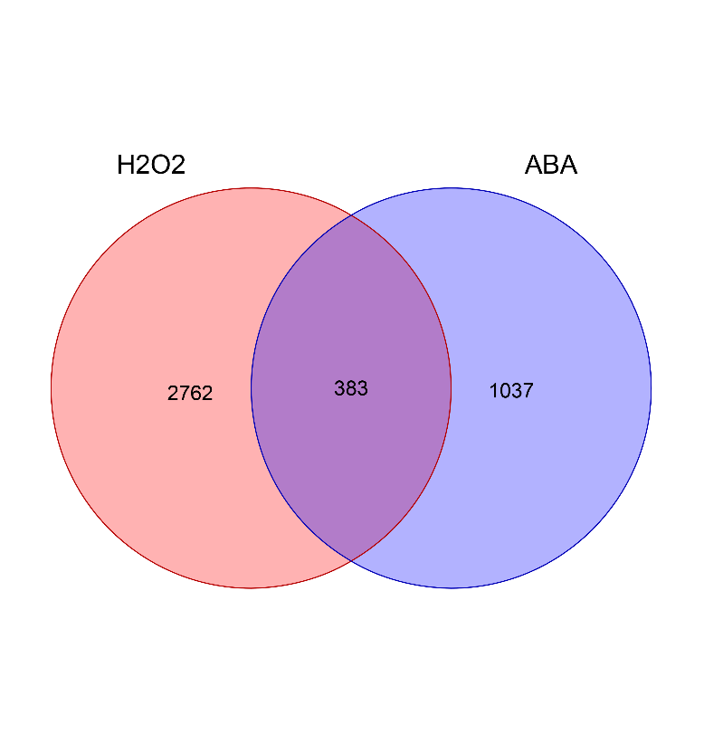
Venn Plots
ABA
ABA
1541
1420
38.15%
25.85%
Root
Shoot
16

Slide 17

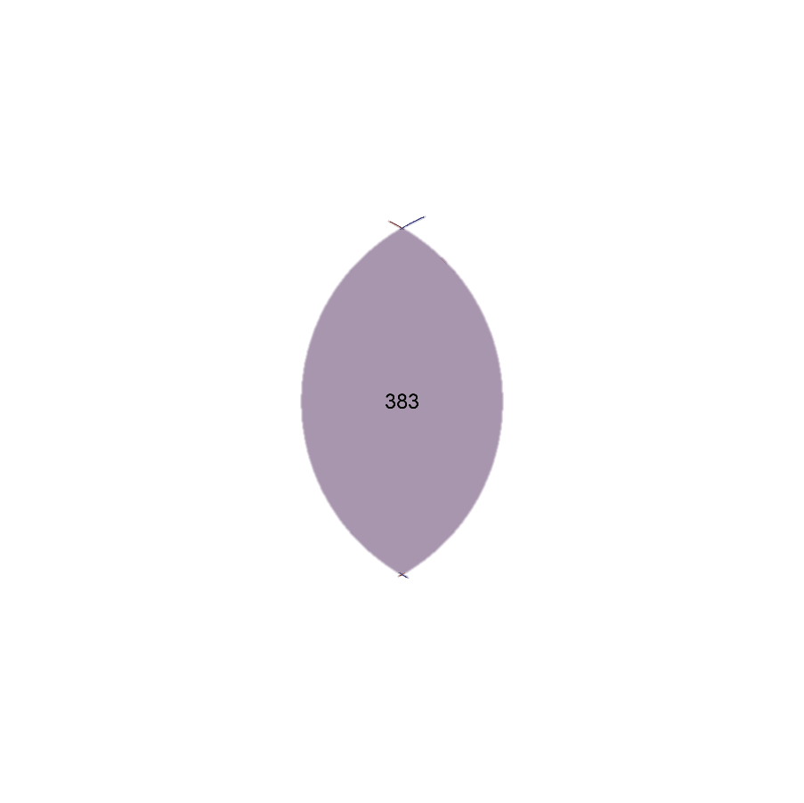
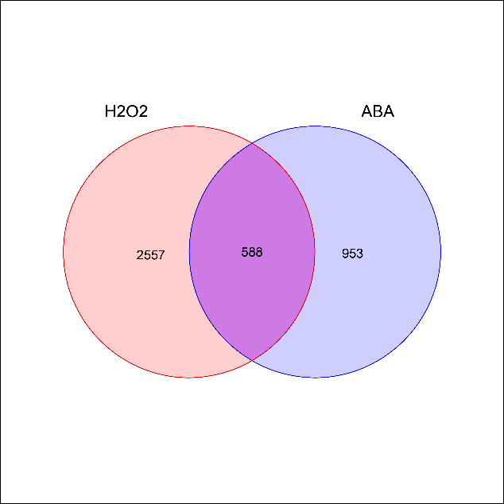
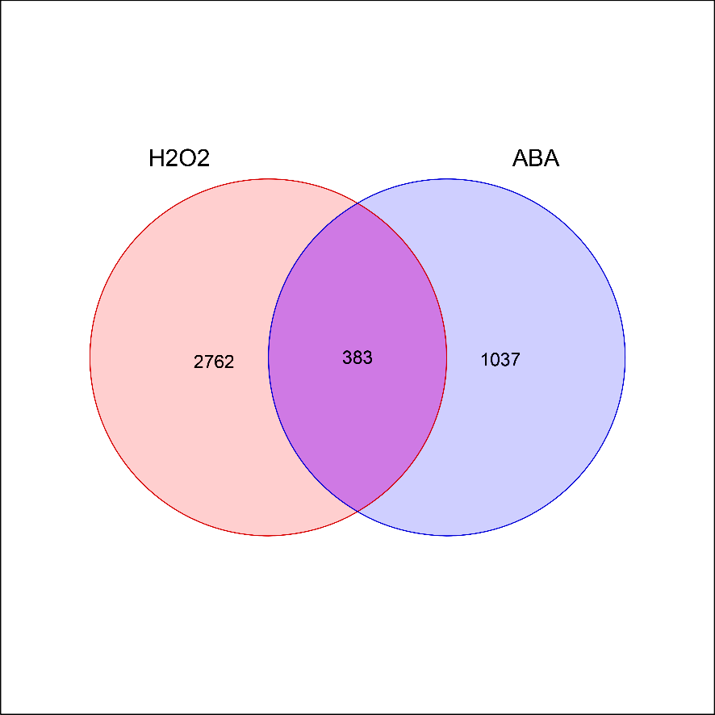
Venn Plots
Root
Shoot
38.15%
ABA
25.85%
ABA
588
383
Gene Ontology Analysis
AgriGO v2 & Panther
17

Slide 18
Gene Ontology

Slide 19
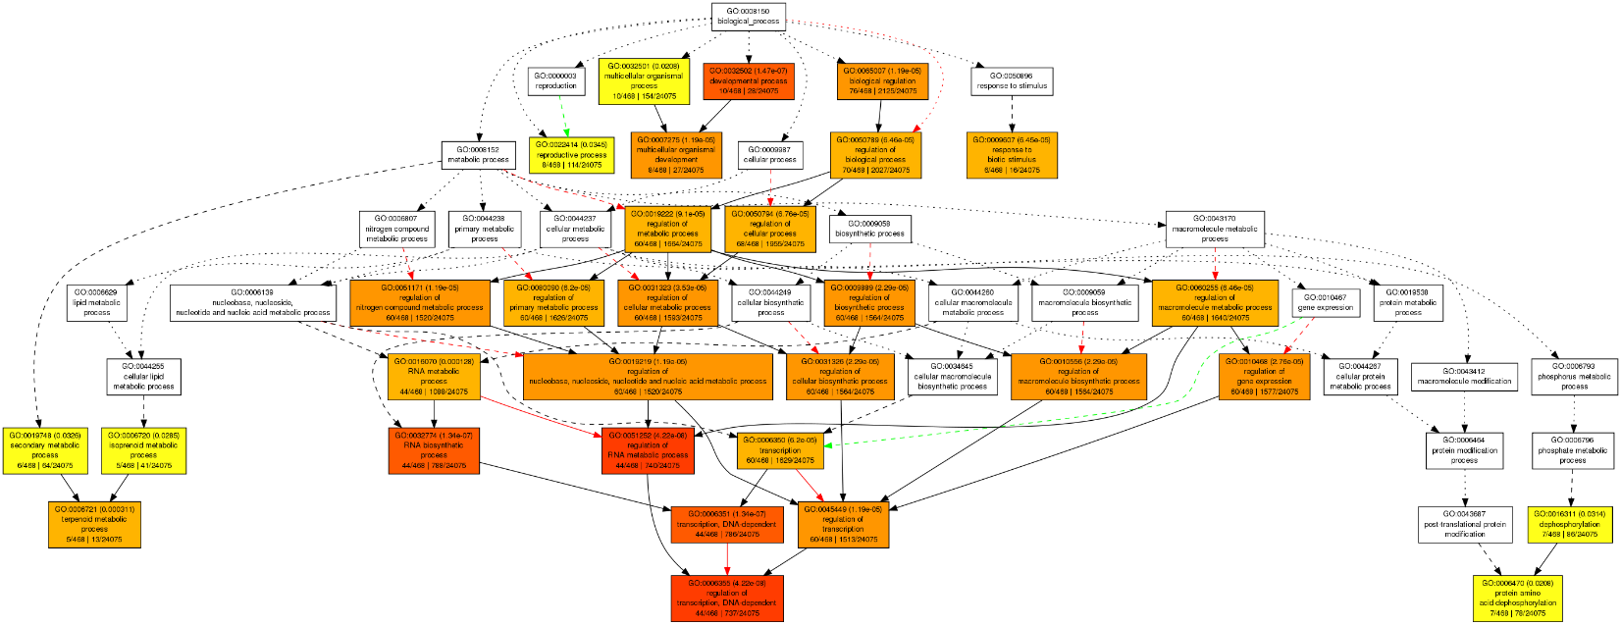
GO Analysis Biological Process
Coregulation genes in ABA and H₂O₂ (sample: root)

Slide 20

GO Analysis Biological Process
Coregulation genes in ABA and H₂O₂ (sample: root)

Slide 21
GO Analysis-Biological Process
Coregulation genes in ABA and H₂O₂ (sample: root)

Slide 22
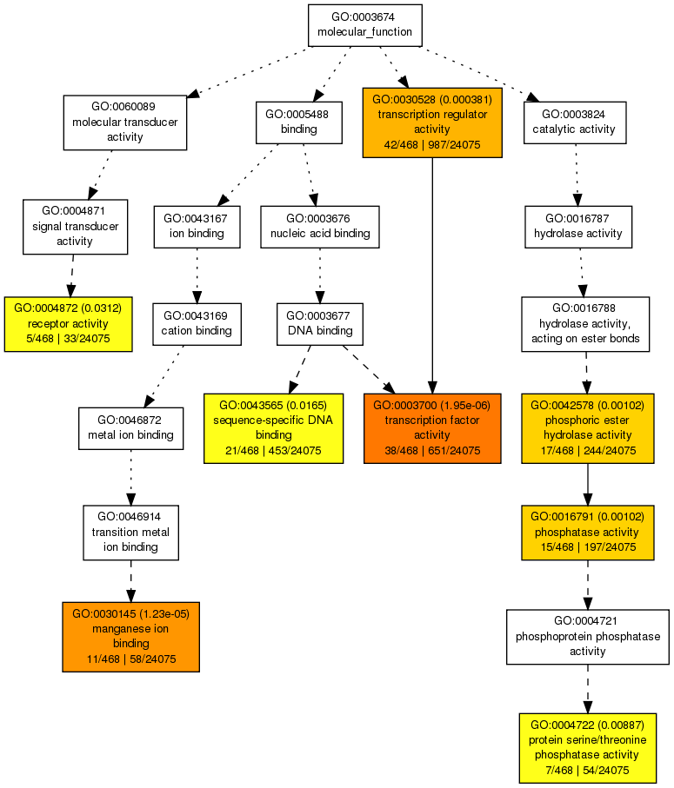
GO Analysis- Molecular Function
Coregulation genes in ABA and H₂O₂ (sample: root)

Slide 23
GO Analysis- Molecular Function
Coregulation genes in ABA and H₂O₂ (sample: root)

Slide 24
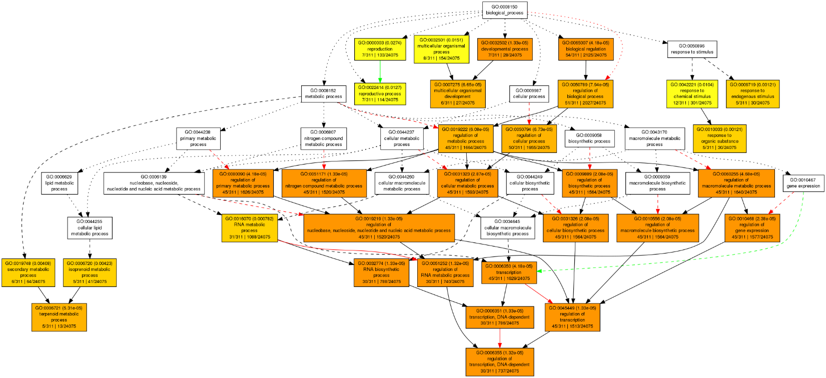
GO Analysis Biological Process
Coregulation genes in ABA and H₂O₂ (sample: shoot)

Slide 25

GO Analysis Biological Process
Coregulation genes in ABA and H₂O₂ (sample: shoot)

Slide 26
GO Analysis-Biological Process
Coregulation genes in ABA and H₂O₂ (sample: shoot)

Slide 27
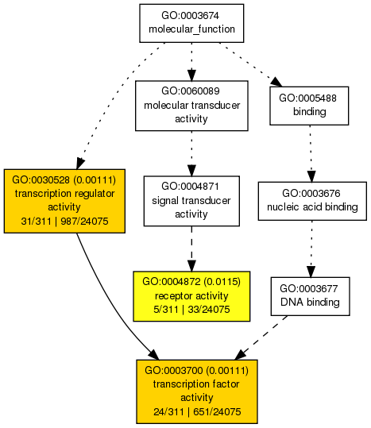
GO Analysis- Molecular Function
Coregulation genes in ABA and H₂O₂ (sample: shoot)

Slide 28
Panther

Slide 29
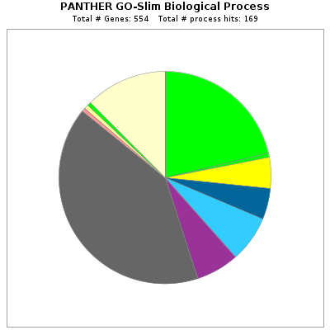
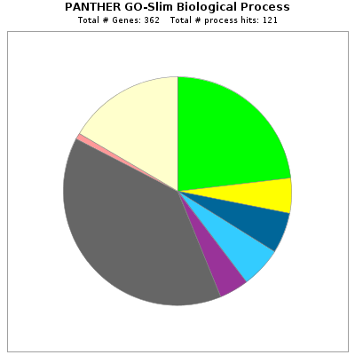
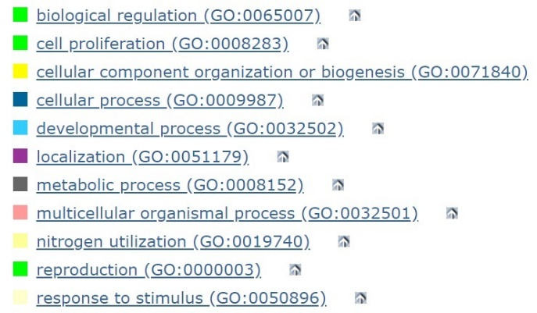

Root
Shoot

Slide 30


Root
Shoot

Slide 31
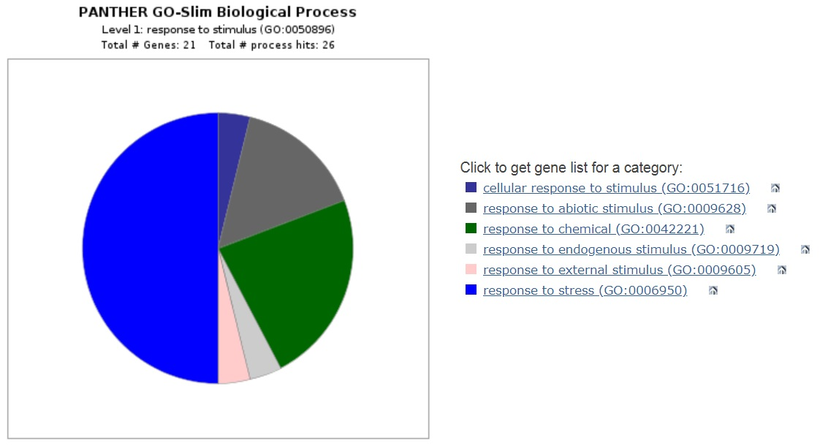
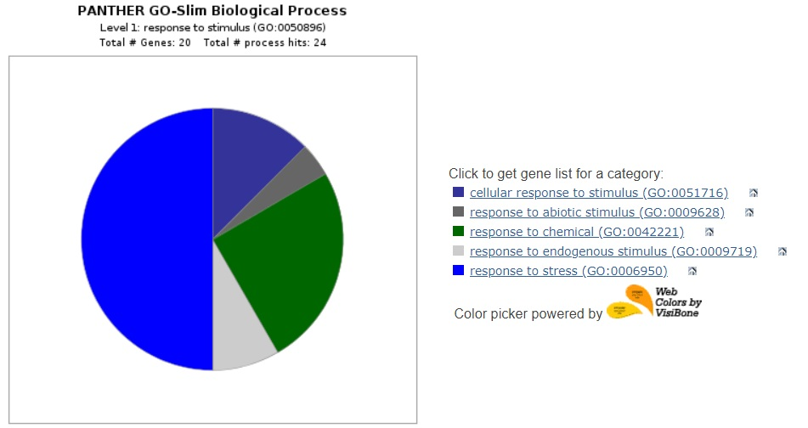
Root
Shoot

Slide 32
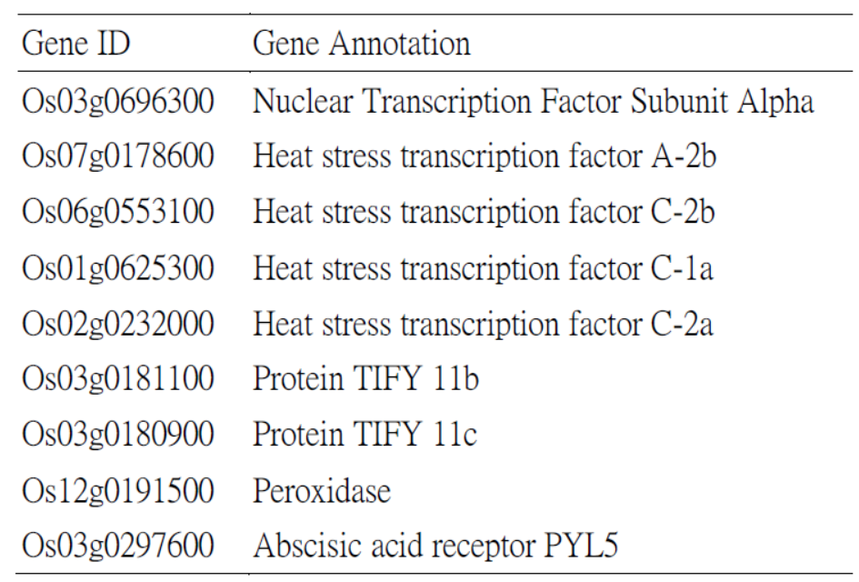
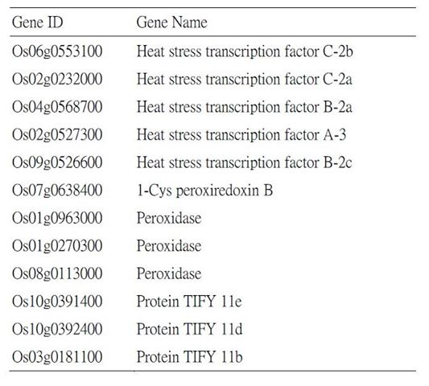
Biological Process Response to Stimulus (Root)
Biological Process Response to Stimulus(Shoot)

Slide 33
Conclusion
Abotic
Chemical
Endogenous
Response to stimulus
Abiotic / Biotic
stress
ABA
?
H₂O₂
Transcription Factors
HSF, TIFY
Antioxidant Enzymes
Peroxidase

Slide 34
Thank you
Q & A
34

Slide 35
Shoot
Root
JA
ABA
Auxin
BL
CK
GA

Slide 36
